Slide 1
Brain-Computer Interface TECHNOLOGY
Presented by
KHUSHBOO YADAV(22013008)
From
B.Tech Computer Science Engineering
In
Bhagat Phool Singh Mahila Vishwavidyalaya, Khanpur Kalan (Sonipat)

Slide 2
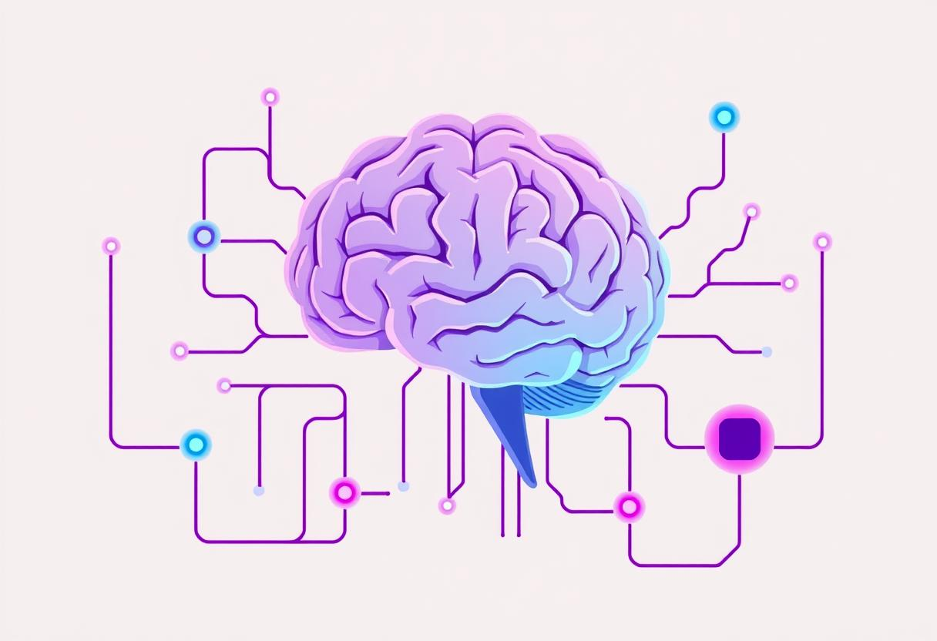
Introduction
BCI = Bridge between brain & external devices
Converts brain signals into commands
Enables mind-controlled interaction

Slide 3
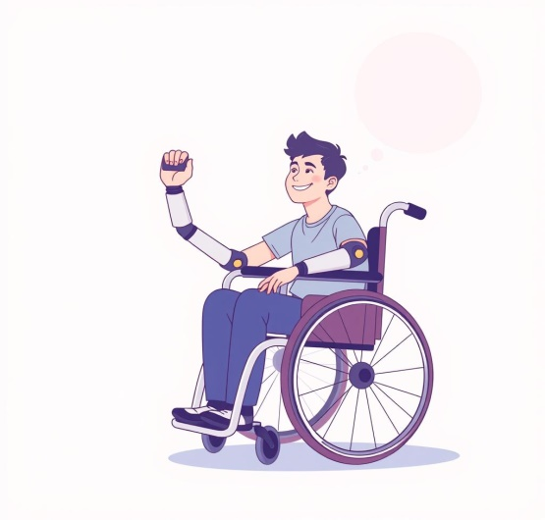
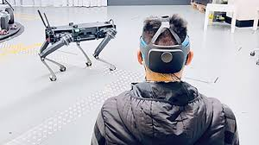
Need for BCI
Assist disabled individuals
Enable hands-free control
Advance neuroscience research
Boost human-computer interaction

Slide 4
How BCI Works
Brain Signal Acquisition: Sensors, often in the form of a headset or implants, capture electrical activity from the brain. Common methods include electroencephalography (EEG) for non-invasive measurement, electrocorticography (ECoG), and intracortical implants for more direct signals.
Signal Processing: A computer receives the raw brain signals and processes them to isolate the relevant features and patterns associated with a user's intended actions.
Feature Classification: The system classifies these processed signals to determine the user's intention.
Device Control: The identified intention is then translated into commands that are sent to an external device, such as a cursor on a screen, a prosthetic limb, or a communication tool.
Feedback: Users receive feedback (visual, auditory, or tactile) to help them learn to control the BCI system more effectively.

Slide 5
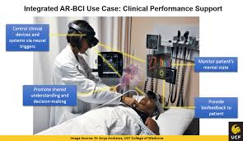
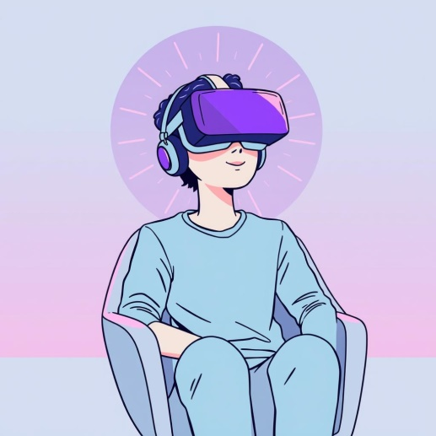
Key Components
Brain Activity Sensor: This device detects neural signals from the brain.
Computer with Software: A computer analyzes the captured brain signals to determine the user's desired action.
Output Device: This is the external device that receives the translated command and performs the action.

Slide 6
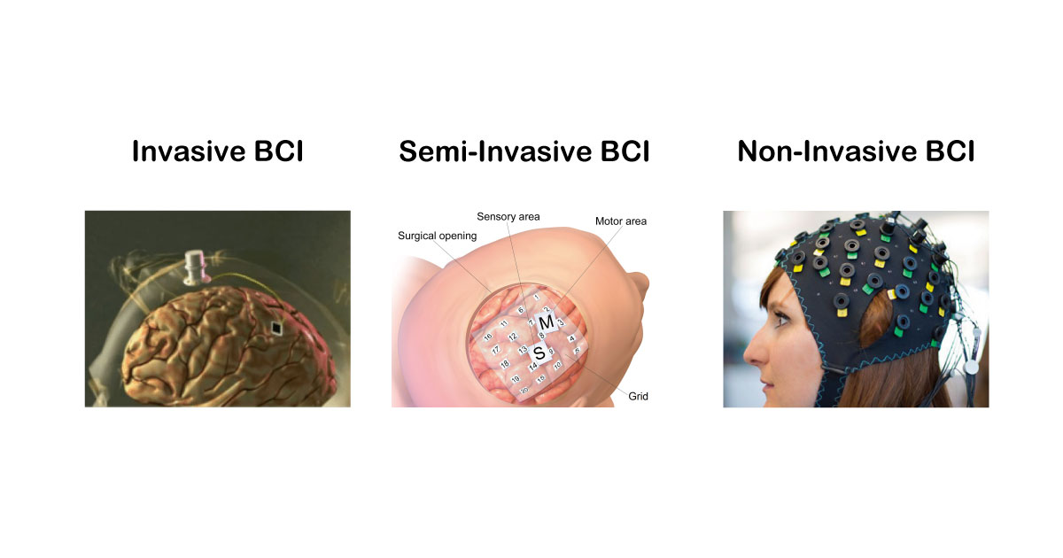
Types of BCI
Invasive: Electrodes are implanted inside the brain (high accuracy, but needs surgery).
Semi-Invasive: Electrodes placed on brain surface (less risky, good accuracy).
Non-Invasive: Uses sensors outside the skull (EEG caps – safe but lower accuracy).

Slide 7
Applications
Neuroprosthetics: Control artificial limbs by thinking.
Communication: Help paralyzed patients "speak" through a computer.
Gaming & VR: Mind-controlled video games.
Mental State Monitoring: Detect fatigue or stress in pilots/drivers.
Military/Space: Control drones or machines remotely using thoughts.
Assistive Technology: Provide alternative communication and control for people with severe motor impairments, such as locked-in syndrome or paralysis, allowing them to interact with the world.
Other Fields: Beyond medicine, BCI research is exploring applications in entertainment, gaming, education, and even military technologies.

Slide 8
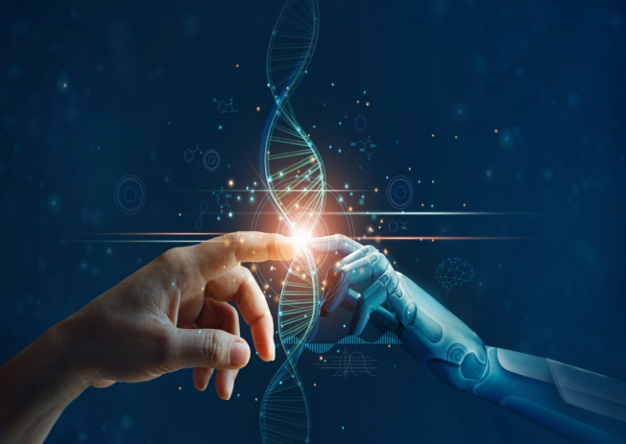
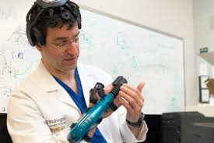
Advantages
Restores Function: Gives independence to people with disabilities.
Better Life Quality: More mobility, more communication options.
Innovation: Pushes the limits of human-computer interaction.

Slide 9
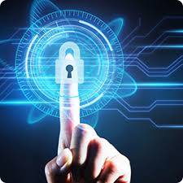
Challenges
Signal noise & accuracy issues
High cost of implementation
Ethical & privacy concerns
Need for real-time processing
Technological Limitations

Slide 10
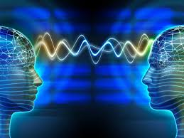
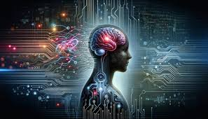
Future Scope
AI-driven BCIs
Fully wireless brain control
Human-AI symbiosis
Brain-to-brain communication

Slide 11
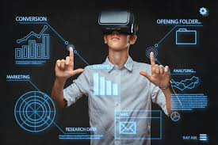
Conclusion
BCI = Future of seamless human-machine interaction
Unlocking limitless possibilities

Slide 12


